Slide 1
1. OAuth
AWD: 5119
Team members:
Andrés López
Erick Riascos
Bryan Yanzapanta
Francisco Suntaxi

Slide 2



History
OpenID
OAuth Core 1.0
Notes:
First of all, a little bit of its history began in November 2006, <CLIC> while Blaine Cook was working on the <CLIC> Twitter OpenID implementation.
Then he joined with other programmers to discuss using OpenID with the Twitter and Magnolia APIs to delegate authentication. They found there were no open standards for API access authorization. So in December 2007, <CLIC> they release the OAuth Core 1.0

Slide 3



WHAT IS ? WHAT IS FOR?
Open Authorization (OAuth)
Access through
Notes:
OAuth stands for Open Authorization. It is a standard designed <CLIC> to allow third-party applications or websites to access resources hosted by other web applications <CLIC> such as Google, Facebook.

Slide 4
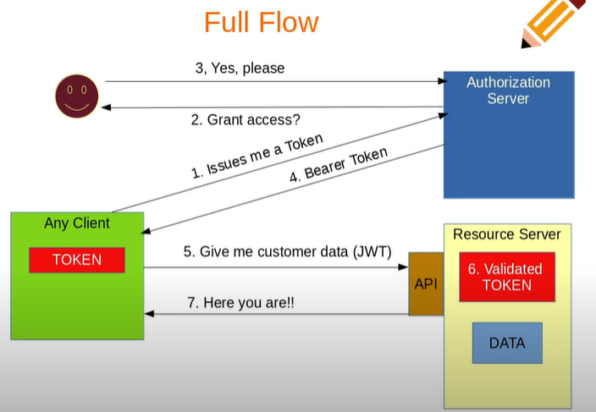
HOW DOES IT WORK?

Slide 5
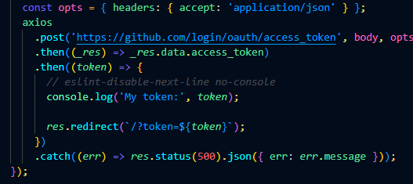
TOKEN
First, The app request a user's GitHub identity
If the user accepts our request
the Users are redirected back to our site by GitHub

Slide 6
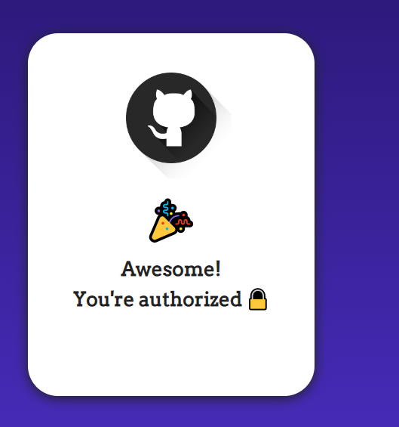
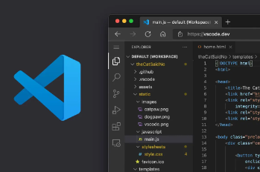
APPLICATION DEMO

Slide 7
VIDEO LINK
https://drive.google.com/file/d/1CnJyuWRWhW3tW-uE5UkakKhgrWwLldC8/view?usp=sharing

Slide 8
THANKS

